Slide 1
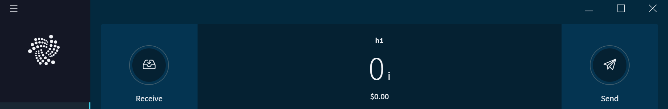
How to Find and / or Recover your IOTA balance in the IOTA Trinity Wallet:
Input your 81 number Seed into Trinity
Double and triple check your seed. A typo in the seed will cause Trinity to open a new empty wallet
If entered correct, Trinity will show your account balance on the main page

Slide 2
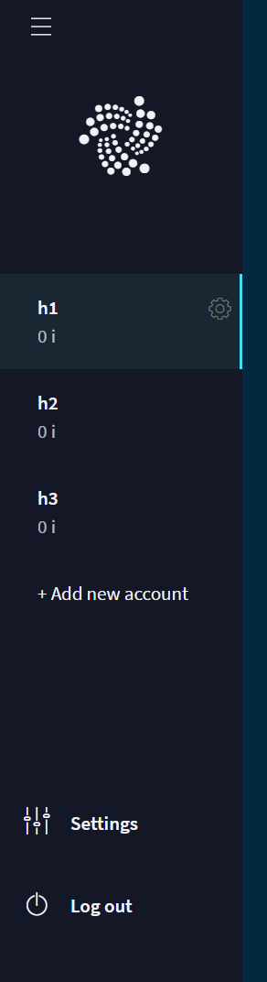
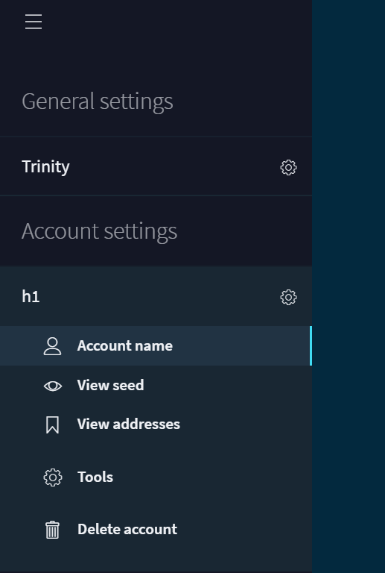
How to Find and / or Recover your IOTA balance in the IOTA Trinity Wallet:
If your balance shows 0 you will need to check the addresses connected to this seed.
Settings =>
Account settings =>
view Addresses

Slide 3
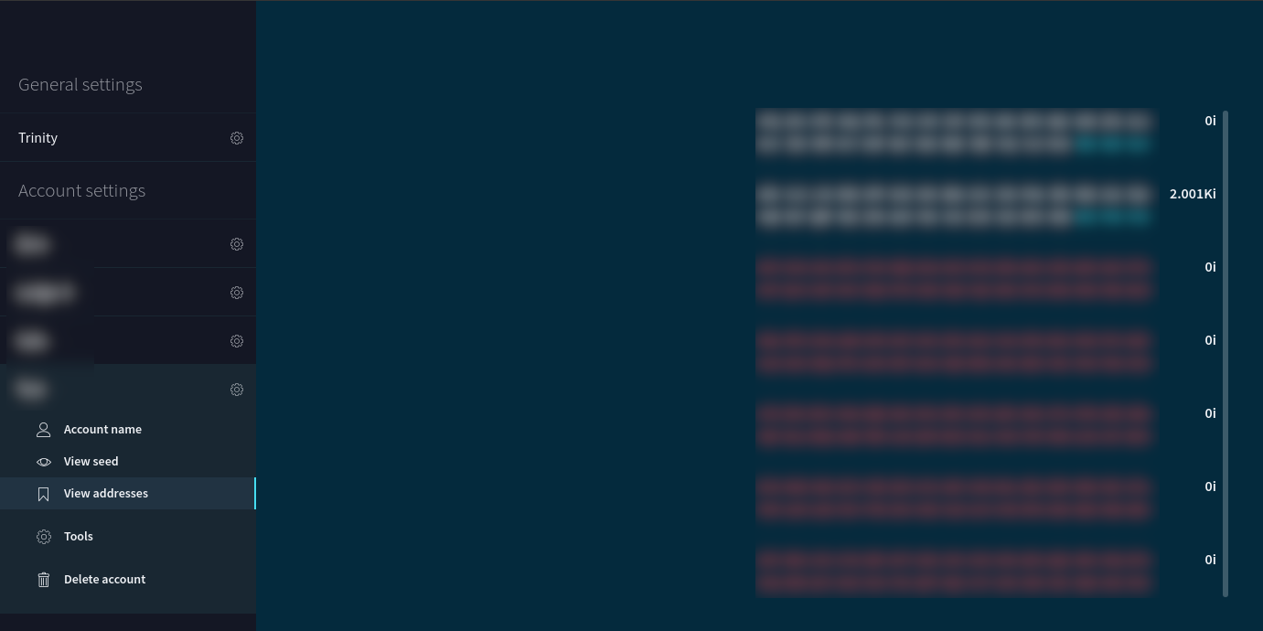
How to Find and / or Recover your IOTA balance in the IOTA Trinity Wallet:
On a correct seed you should see several (more than one) addresses

Slide 4
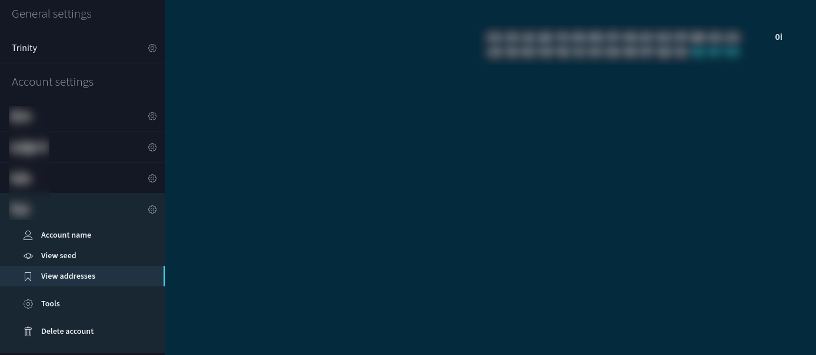
How to Find and / or Recover your IOTA balance in the IOTA Trinity Wallet:
A new, never used seed will look like an empty wallet and have only one address

Slide 5
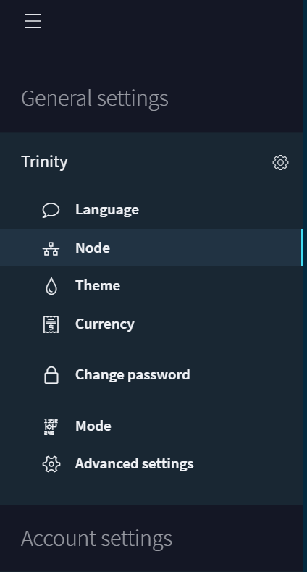
How to Find and / or Recover your IOTA balance in the IOTA Trinity Wallet:
If you have a seed that contains less than 81 characters you can add the number “9” until 81 characters are full.
If your balance now shows 0 and you have not used the seed in the last 1-2 years you will need to do a “snapshot transition”. In the general settings click “Node”

Slide 6
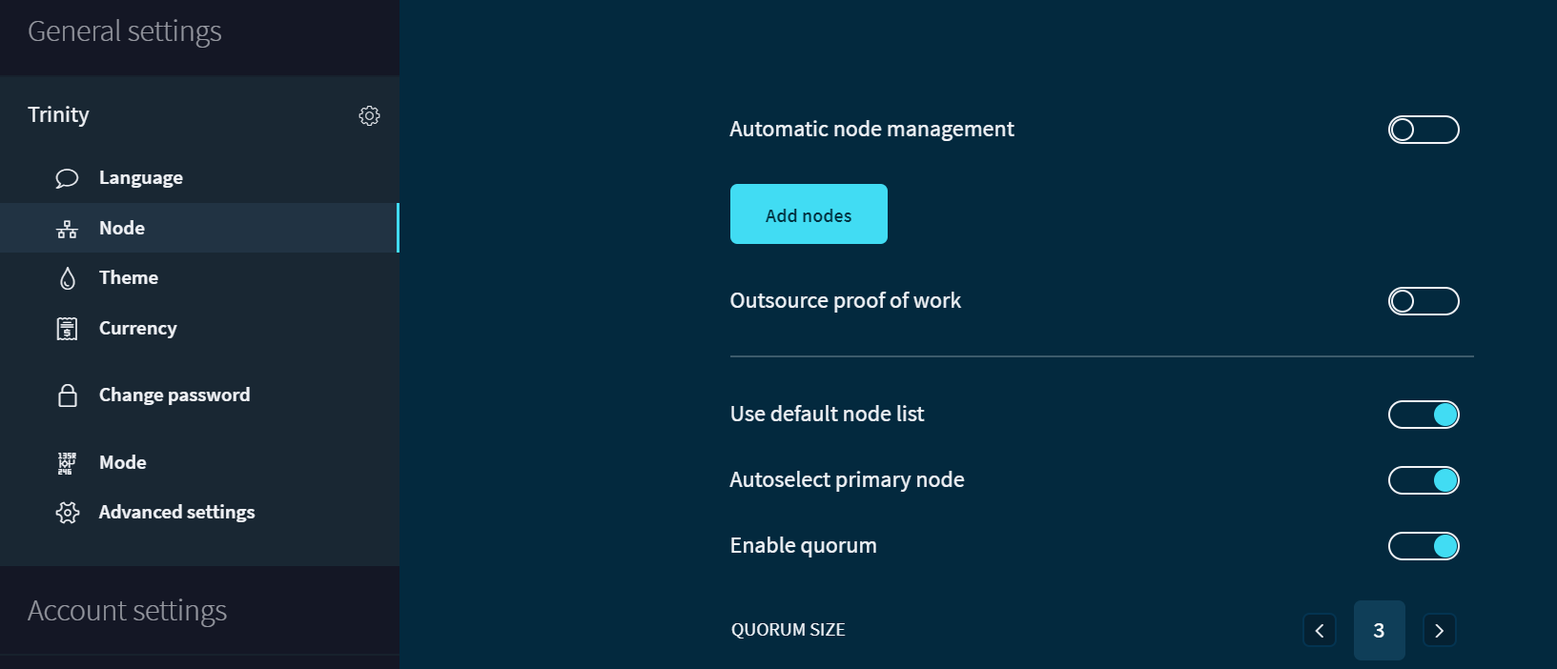
How to Find and / or Recover your IOTA balance in the IOTA Trinity Wallet:
Perform these step by step: 1. Disable “automatic node management”, 2. Disable outsource proof of work, 3. disable autoselect proof of work, 4. disable autoselect quorum

Slide 7
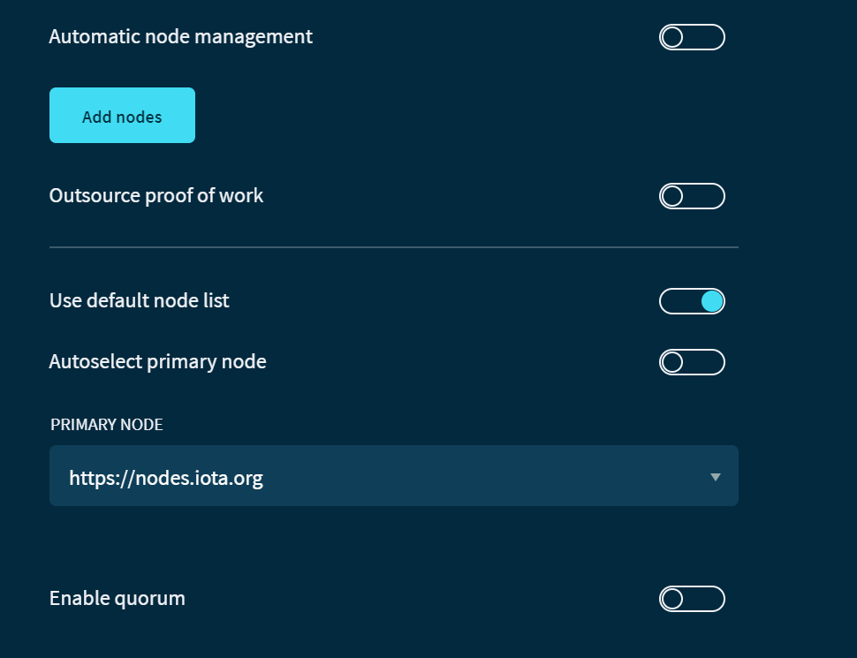
How to Find and / or Recover your IOTA balance in the IOTA Trinity Wallet:
This is how it should look now. Click “save”

Slide 8
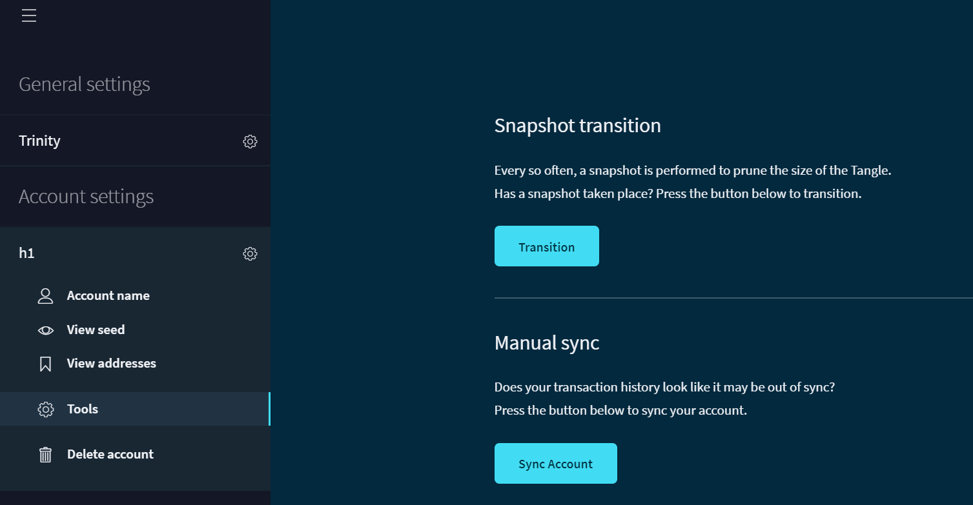
How to Find and / or Recover your IOTA balance in the IOTA Trinity Wallet:
Last step – move to your account, under the “tools” tab, click “Snapshot transition” until your tokens show up in Trinity

Slide 9
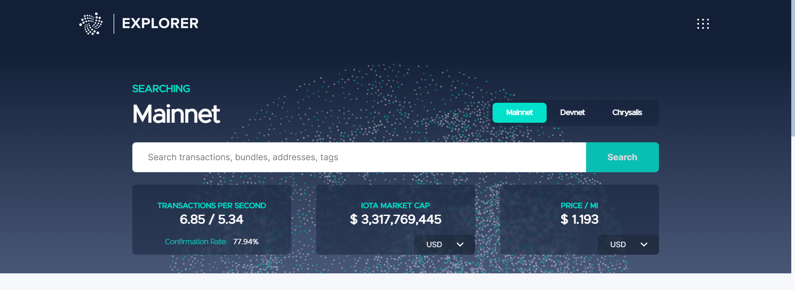
Reclaim cases:
If after all the steps above your balance is still not there you might be victim of some of the following issues and need to follow this steps:
Get the address to where your tokens have been sent after you purchased them. This should be still available in the exchange where you bought them. Exchanges need to keep years of records for all outgoing transcations.
Copy the address and visit https://explorer.iota.org/

Slide 10


Reclaim cases:
If the explorer shows 0 balance and there are also outgoing transactions than it is necessary to follow the outgoing transactions
If the explorer shows 0 balance, AND there are no outgoing transactions, then it might be a reclaim case. It is possible to search your address and compare it with the list on the following page for a first assessment. ⚠️ THE LIST CONTAINS ONLY ADDRESSES WITHOUT CHECKSUM. Should the address have 90 characters, make sure to remove the last 9 characters from the address that is being compared https://gist.githubusercontent.com/cyclux/2bb05d873c4ec6115cad1d100263d489/raw/612a49e46091586957448f6606ea981ab18022e7/snapshot_validation_20171023.txt
If the text near the address says AVAILABLE then it is possible to access the tokens by inserting the correct seed into Trinity
If the text near the address says KEY_REUSE or CURL_NOT_TRANSITIONED
Please send the address (WARNING: NEVER SHARE THE SEED) to the IOTA Foundation for further verification and confirmation.

Slide 11
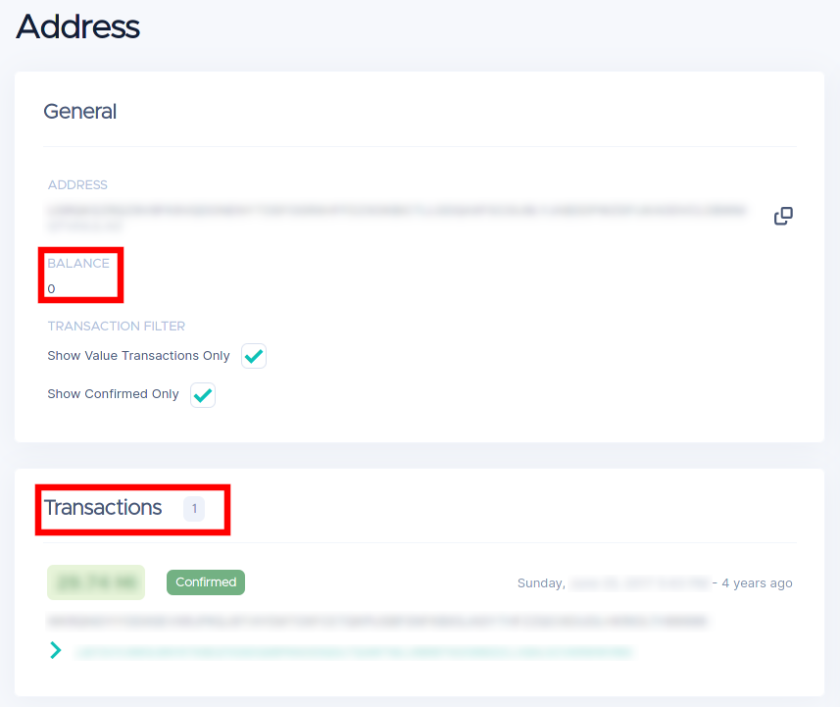
Reclaim cases:
Example of an address that needs to be reclaimed. The Balance shown in 0. There is only an incoming transaction AND no outgoing transactions with ##.## MIOTA.

Slide 12
IOTASEED.IO or Online Seed Generator scam:
Did the tokens move away between January 2018 and January 2019 and the seed was generated using iotaseed.io, then it is a theft case from the iotaseed.io scam.
This is the relative article from Europol: https://www.europol.europa.eu/newsroom/news/cryptocurrency-iota-international-police-cooperation-arrests-suspect-behind-10-million-eur-theft
This was the procedure that has been followed by one of the IOTA community users: The local police department received a questionnaire from the state criminal investigation office which was to fill out. It was e.g. about the cyrpto-background; how the user found iotaseed.io; amount of coins,... After answering all questions the next steps was basically that they are preparing a class action against the thief. This also includes Europol. So the users answers will be forwarded and collected at a higher instance before the perpetrator is sued.

Slide 13
The Trinity incident:
Did the tokens move away between the 12th December 2019 and the 12th February 2020, the user might be victim of the Trinity Incident, that involved the theft of the seed during the time Trinity integrated the Moonpay services. In that case send the address to the IOTA Foundation for further verification. (More information here: https://blog.iota.org/trinity-attack-incident-part-1-summary-and-next-steps-8c7ccc4d81e8)
Did the tokens move away between the 29th February 2020 and the 10th March 2020, then it looks like the user was aware of the theft and did the migration using the migration tool (https://blog.iota.org/seed-migration-tool-now-available-c253ccd9d23c/).
In this case there should be a SeedVault.kdbx and a journal.log file on their system. Make sure now to add the password protected SeedVault to Trinity. Be aware that the SeedVault file is password protected that has been chosen by the user during migration. Without the password it will not be possible to recover the tokens. . This video shows the whole migration and how to add the SeedVault to Trinity (https://www.youtube.com/watch?v=mjex3IU44VY)
Did the tokens move away on or after the 11th March 2020, then the user did not follow the migration, the seed might have been part of the aforementioned incident and the tokens have been stolen. In this case we encourage users who have had tokens stolen to file a report with their local police and to cite the following case number when doing so: LKA Berlin, Center for Cybercrime, case number: 200213-1717-i00290.

Slide 14
LEDGER NANO S or X issues:
Make sure the same account is in use (24 words, mnemonic recovery words) as when it was set up the first time
The INDEX is fundamental to load the correct IOTA Seed. Your Ledger * index = unique seed. Ledger * index 0 will generate seed ABC while Ledger * index 10 will generate seed XYZ
Make sure you use the original USB Cable if possible. Don't use a USB HUB or USB ports on the display/monitor/keyboard but connect it directly to your system
Close all applications that can access the Ledger device e.g. Ledger Live, Browsers with metamask or the Brave browser
Remove the Ledger device from the Windows Device Manager (right-click > uninstall device), unplug it, reconnect it and let Windows install the drivers again
If you still experiencing issues with the Ledger, please follow the following procedure: Close everything on your computer. This includes Ledger Live which should not be running at the same time as Trinity. Plugin your Ledger. Unlock it with your passcode. Browse to the IOTA App on your Ledger and enter the app. Now start Trinity and try setting up your account again.
I have lost the index
⚠️ THIS TOOL IS A COMMUNITY TOOL AND IS NOT ENDORSED BY THE IOTA Foundation and will break the security of using a hardware wallet. This tool is made to find the correct Ledger account index in case you forgot to write it down. https://github.com/HBMY289/iotaLedgerIndexFinder

Slide 15
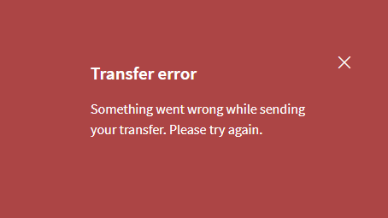
LEDGER NANO S or X issues:
If you try to send funds with your Nano, but get the following message
Follow the steps described in this guide:

Slide 16
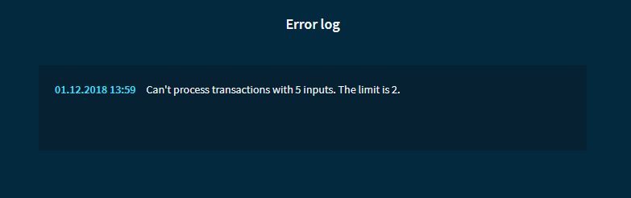
LEDGER NANO S or X issues:
For some time now the official iota Trinity wallet is compatible with the hardware wallet Ledger Nano S. Although Trinity offers rather seamless integration, there are still hardware restrictions that can lead to the above error message when trying to send funds.
As this is a rather generic error message you should first check the Trinity error log to see a more detailed description. You can access it via the main menu (Trinity → Error Log).
If you see an entry similar to the one shown below, you are affected by the issue described here.

Slide 17
LEDGER NANO S or X issues:
The Ledger Nano S hardware has a very limited amount of available memory. Due to the size of private keys and signatures in the iota environment, it is not possible at the moment to send a transaction that uses funds from more than two addresses (inputs). When sending a transaction you do not have manual control over which addresses are used as inputs and this issue will most likely occur if you have sent funds to your ledger account multiple times using new receive addresses each time. The result of this will be that your funds are spread over many addresses, requiring Trinity to use multiple input addresses when larger amounts of iotas should be sent.
How to fix this situation?
Remember that not all the funds are blocked, but we can still send a transaction with a maximum of two inputs. We will always take two addresses and send their funds to the same single target address until all iotas are consolidated there and sending the full amount will be possible again. While we cannot tell Trinity which input addresses to use for this merge process, we can nudge it to use the ones we want by sending the right amount of iotas.
First, check how your funds are distributed over your addresses by using the command Account → Account Management → View Addresses from the Trinity main menu.
.

Slide 18
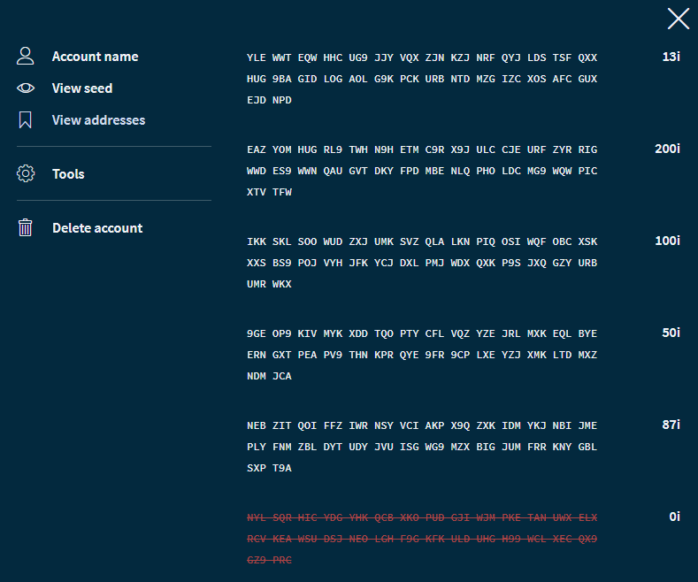
LEDGER NANO S or X issues:
In the shown example the iotas are spread over 5 addresses. We will take the one on top (YLE WWT…) as the target address and try to send all funds to this address. Now we can send the first transaction, by adding the balances of the two lowest addresses (87i + 50i = 137i). If we send a transaction over 137i Trinity will start at the lowest address and look for input addresses until it has enough to cover what we want to send. Sending 137i, in this case, will make sure that Trinity uses the addresses we want.

Slide 19
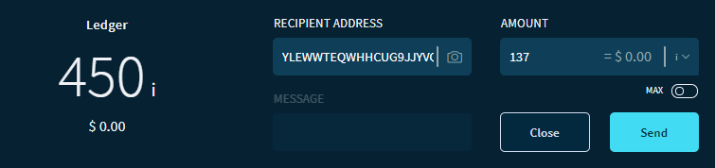
LEDGER NANO S or X issues:
Do the same for your list of addresses and write down the target address and the added balance of the two addresses lowest address with funds. Then send a transaction to the target address using the calculated balance..

Slide 20
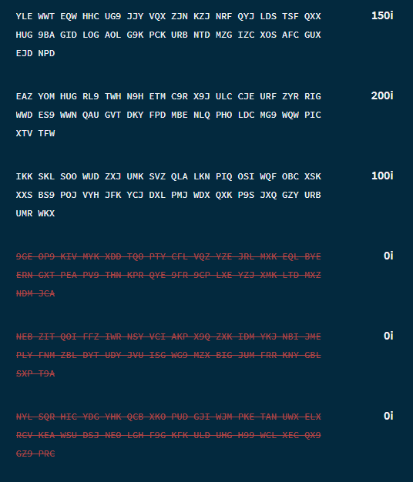
LEDGER NANO S or X issues:
Check and Approve the transaction on your Ledger. After the new transaction is confirmed, your list of addresses will have changed.

Slide 21
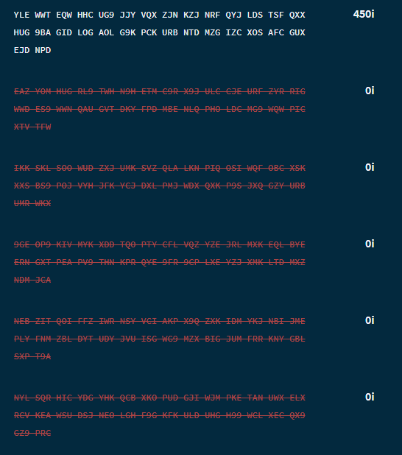
LEDGER NANO S or X issues:
Depending on the number of addresses that your iotas were spread over, you will need to repeat this task. In the shown example we will have to send another transaction to the same target address over 300i until finally the full balance is consolidated in a single address again.

Slide 22
LEDGER NANO S or X issues:
Depending on the number of addresses that your iotas were spread over, you will need to repeat this task. In the shown example we will have to send another transaction to the same target address over 300i until finally the full balance is consolidated in a single address again.
Now we can send the full funds again without any issues.

